Slide 1
Smart Traffic Lights

Slide 2
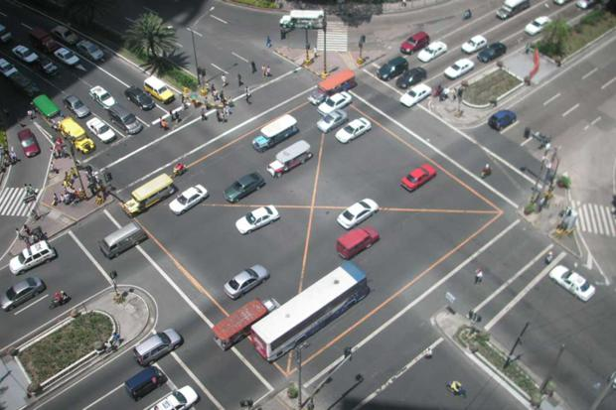
The problem
Traffic lights’ timings and intervals are fixed.
This leads to:
Traffic Jams and Congestion
Increased Travel Time
High air and noise pollution

Slide 3

The solution
Dynamic timings of red traffic light based on the number of vehicles on each road of the square.

Slide 4
How it works
Camera Input
Processing
Algorithm
Sending Output
Dynamic Lights
Input is taken from a rotating camera or 4 stationary cameras at centre of the square.
It is then sent to the nearby Computer through WiFi of Raspberry Pi or uploaded to the server through the same Pi.
Processing is done to get the number of vehicles from the input.
Faster R-CNN implemented in tensorflow is used along with Computer Vision.
An algorithm decides which of the three lights- Red, Yellow, Green should glow.
It depends on the number of incoming vehicles from each of the four roads.
The Output of the algorithm is send back to the same Raspberry Pi.
This is done either using the same WiFi connection or sending the signal through the internet from the same server.
Traffic Lights glow automatically based on the number of vehicles.
Hardware circuit is implemented on the same Raspberry Pi and output is given to the connected traffic lights.

Slide 5
Implementation Challenges
Designing the algorithm that works for all the cases.
Real time accurate processing of the trained model.
Speed of sending and receiving the camera fed from and to the controller.

